Slide 1

Information System Management- Lecture -03
The Role of the
Systems Analyst
Md. Manirujjaman | Lecturer | Dhaka International University
1

Slide 2

FOUNDATIONS
What Is a Systems Analyst?
IN PRACTICE
A systems analyst studies, designs, and improves information systems so that they meet real business needs — acting as the bridge between the people who use a system and the developers who build it.
A university wants to modernise how it handles student data.
The analyst studies how admissions and results are currently processed, then designs an automated system that fits how the registrar, faculty, and students actually work.
“A person who conducts a methodical study and evaluation of an activity — such as a business — to identify its desired objectives, in order to determine the procedures by which those objectives can be achieved.”
— Random House Dictionary
2

Slide 3


HISTORICAL PERSPECTIVE
Born Out of War and Industry
PRE–WORLD WAR I
POST–WORLD WAR II · 1950s–60s
The Industrial Landscape
Cost, Control, and Weapons
Factories relied on labor-intensive, manual work.
Automation began making goods faster, cheaper, and more efficient.
Labor unions and rising wages created new demand for analysts.
Analysts improved working conditions and built incentive systems and training programs.
Government began stockpiling military weapons at scale.
Analysts ran cost/benefit analyses to evaluate weapon systems.
Inventory-control techniques determined optimal usage and quantities.
3

Slide 4






HISTORICAL PERSPECTIVE
Innovations Forged by Military Need
Six systems emerged directly from wartime priorities — each later reshaping civilian technology and, with it, the analyst’s toolkit.
Radar Systems
Early Computers
Cryptographic Machines
Detection and tracking that redefined defense and, later, air traffic control.
Room-sized machines that proved large-scale calculation could be automated.
Code-breaking devices that pioneered structured, logical information processing.
Inventory Control
Operations Research
Mass-Produced Penicillin
Systems for tracking and optimizing vast quantities of military supplies.
Mathematical methods for optimal decision-making under constraints.
Industrial-scale production planning applied to save lives.
4

Slide 5

HISTORICAL PERSPECTIVE
From Record-Keeping to a Recognized Profession
1950s–60s
1970s–80s
Computers used mainly for payroll and record-keeping.
Programmers handled both analysis and programming tasks.
Growing need to link business needs with technical solutions.
Systems Analyst formally recognized as a role.
Structured analysis and design methods introduced.
5

Slide 6
HISTORICAL PERSPECTIVE
Into the Age of Integration and Strategy
1990s
2000s–Present
Databases and personal computers expand rapidly.
Analysts focus on integration and decision-support systems.
Object-oriented, agile, and cloud-based approaches take hold.
Analysts become technology planners and digital-transformation advisors.
Greater focus on business strategy and user experience.
6

Slide 7


CORE COMPETENCIES
What Systems Analysis Demands
Effective analysis rests on two pillars held in balance — neither is sufficient alone.
Interpersonal Skills
Technical Skills
Deal with people, relationships, and communication within the business — understanding user needs and building trust.
Cover the methods, tools, and techniques of systems and computer analysis — turning needs into working solutions.
Together, the two let an analyst understand real needs, solve genuine problems, and deliver solutions people will actually use.
7

Slide 8



INTERPERSONAL SKILLS
Speaking the Language of the Business
The human side of analysis — four abilities that turn cooperation into results.
Communication
Understanding
Speaks the user’s language across every managerial level — listening and discussing openly rather than hiding behind documentation.
Identifies problems, assesses their impact, and aligns solutions with company goals, staying sensitive to how systems affect people.
Teaching
Selling
Educates users on how a system works and provides continuous support, helping them adapt with confidence.
Promotes system ideas and builds enthusiasm, convincing users and management to adopt new technology.
8

Slide 9






TECHNICAL SKILLS
The Toolkit Behind Every Solution
The analytical craft — six abilities that turn requirements into working systems.
Creativity
Problem Solving
Project Management
Transforms user ideas into workable system models and design alternatives.
Breaks complex issues into manageable parts to find the best-fit solution.
Manages time, cost, and resources while coordinating teamwork effectively.
Dynamic Interface
Questioning Attitude
Knowledge Base
Integrates technical and non-technical concerns within one coherent design.
Continually asks what, why, when, where, who, and how of system operations.
Grounded in computer fundamentals and a sound understanding of business processes.
9

Slide 10
APPLYING THE SKILLS
Where Each Skill Set Matters Most
The balance between interpersonal and technical skill shifts as a project moves through its lifecycle.
1
2
3
4
Analysis Phase
Design Phase
Implementation Phase
Maintenance Phase
High focus on interpersonal skills — gathering user requirements and translating them into system needs.
Emphasis shifts to technical skill — building system architecture and design detail.
Both skill sets combine — testing, user training, and system transition.
Limited analyst involvement, unless new or unexpected issues arise.
Interpersonal-led
Technical-led
Balanced
Minimal
10

Slide 11
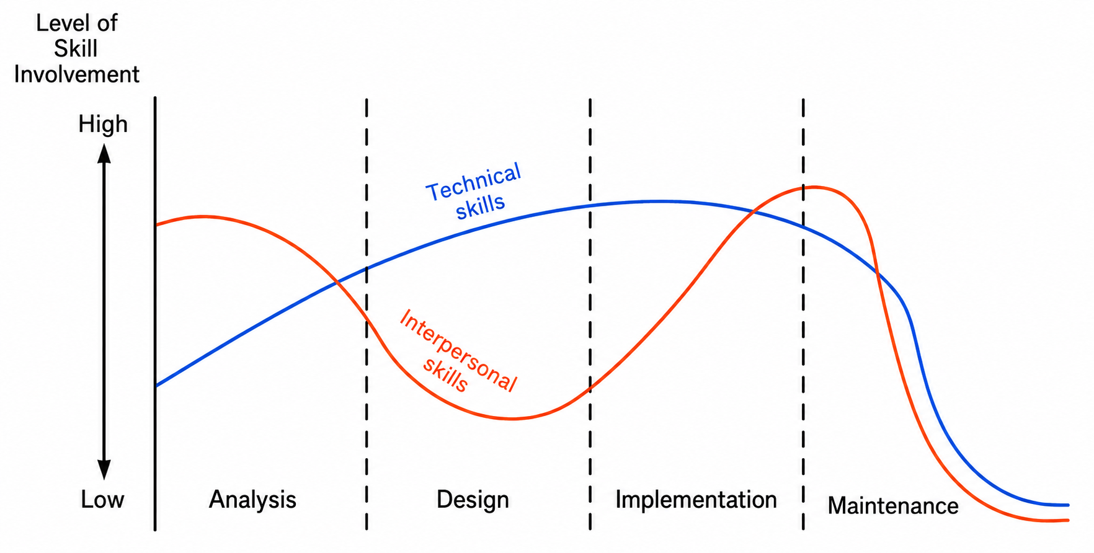
APPLYING THE SKILLS
Interpersonal vs. Technical Emphasis Over Time
Figure 1 — the same four phases, now traced as two skill curves through the project lifecycle.
11

Slide 12



BUILDING THE PROFESSION
How Does an Analyst Acquire These Skills?
Education, hands-on experience, and personality traits combine — most analysts build this foundation through formal study.
COMMON UNDERGRADUATE MAJORS
SPECIALIZED COURSEWORK TODAY
Accounting
Systems Analysis
Project Management
Management
Database Design
Information Systems
Over 30 universities now offer advanced doctoral programs in Systems Analysis and Design — a mark of how far the field has matured.
12

Slide 13



BUILDING THE PROFESSION
Academic Background and Experience
Four foundations that formal education and fieldwork together build.
Systems Theory & Behavior
Application-Area Knowledge
Understanding how systems operate within organizations and how people respond to them.
Familiarity with financial accounting, marketing, personnel, and production control.
Competence in System Tools
Hardware & Software Experience
Practical experience with programming, database languages, and methodologies.
Understanding specifications well enough to guide system and technology selection.
13
Notes:
Systems Theory & Behavior
An analyst needs to understand how a system works inside an organization and how people interact with that system.
Example: If a university introduces a new attendance system, the analyst should understand how it will affect teachers, students, and administrators.
Application-Area Knowledge
The analyst should have basic knowledge about the business area where the system will be used, such as accounting, marketing, HR, or production.
Example: If someone is designing software for a bank, it is difficult to design a good system without understanding basic banking processes.
Competence in System Tools
The analyst should have practical knowledge of programming, databases, and system development methodologies.
This means the analyst should not only understand the problem but also understand how a technical solution can be developed.
Hardware & Software Experience
The analyst should understand which hardware and software are suitable for a particular situation.
Example: For a small company, the analyst may need to decide whether an expensive physical server is necessary or whether a cloud-based solution would be better.

Slide 14



BUILDING THE PROFESSION
Personal Attributes of a System Analyst
Skill alone is not enough — five character traits shape how effectively that skill is applied.
Authority
Confidence to lead and make decisions under pressure.
Communication Skill
Expresses ideas clearly and guides users logically.
Creativity
Willing to explore new methods and innovative solutions.
Responsibility
Owns decisions and stays accountable for outcomes.
Varied Skills
Flexible enough to manage diverse projects and change.
14

Slide 15






THE ANALYST’S MANY HATS
The Multifaceted Role of the System Analyst
A system analyst performs multiple roles to ensure successful development and user satisfaction — each demanding its own skills, attitudes, and approach to people, technology, and organizations.
Change Agent
Investigator
Monitor
Architect
Psychologist
Salesperson
Motivator
Politician
15
Notes:
Change Agent
A new system often changes the way an organization works. The analyst helps manage that change.
Example: Introducing biometric attendance instead of manual attendance.
Investigator
The analyst finds the real cause of a problem.
Example: Investigating why result processing is repeatedly delayed.
Monitor
The analyst checks whether the project is progressing according to time, cost, and quality requirements.
Architect
The analyst converts user requirements into a technical system design.
Example: If students ask for online registration, the analyst decides what modules, database, and workflow are needed.
Psychologist
The analyst needs to understand user behavior, fear, and resistance.
Example: If employees are afraid of using new software, the analyst understands their concerns and supports them.
Salesperson
This does not mean selling a product. The analyst must present and promote the proposed system idea convincingly to management and users.
Motivator
The analyst encourages users to accept and use the new system.
Politician
This does not refer to political parties. The analyst uses diplomacy and negotiation to balance conflicting interests between departments.

Slide 16
THE ANALYST’S MANY HATS
Key Roles I: Driving and Steering Change
1. Change Agent
2. Investigator & Monitor
3. Architect
Introduces and manages organizational change through new systems.
Encourages user participation to gain acceptance.
Investigator: uncovers hidden issues affecting performance.
Monitor: tracks project time, cost, and quality to prevent overruns.
Translates user requirements into technical system design.
Bridges users’ ideas and programmers’ implementation.
16

Slide 17
THE ANALYST’S MANY HATS
Key Roles II: Winning People Over
4. Psychologist
5. Salesperson
6. Motivator
7. Politician
Understands human behavior and workplace relationships.
Handles emotion and resistance gracefully.
"Sells" the system idea at every stage.
Uses persuasion and presentation to build confidence.
Encourages users to accept and use the new system.
Provides training and support after go-live.
Uses diplomacy and negotiation for support.
Balances conflicting interests to maintain harmony.
17

Slide 18
THE MIS ORGANIZATION
Where the Analyst Sits in the MIS Structure
Director of MIS
Administration
Systems Analysis
& Design
Programming
Operations
User Liaison
Project-
Oriented
Pool-
Oriented
Functional
Applications
Software
Maintenance
Figure 2 — a general organization chart of an MIS division.
18
Notes:
1. Administration
This section manages planning, budgeting, staffing, policies, and other administrative activities.
2. Systems Analysis & Design
Here, analysts collect user requirements, analyze problems, and prepare the system design.
This branch can be organized in different ways, such as:
Project-Oriented
Pool-Oriented
and the lecture later also introduces the Functional structure.
3. Programming
After the analyst prepares the design, programmers develop the actual software or code based on that design.
Programming work may include:
Applications
Software
Maintenance
4. Operations
After the system is developed, this section handles its day-to-day operation, scheduling, data management, and related tasks.
5. User Liaison
This section maintains communication between users and the MIS department. It carries user problems, requests, and feedback to the MIS team.

Slide 19








PRIMARY FUNCTIONS OF AN MIS FACILITY
Four Pillars of the MIS Facility
Administration
Systems Analysis
& Design
Programming
Operations
1 · ADMINISTRATION — FOUR ACTIVITIES
User Liaison
Long-Range Planning
Budget Planning & Control
Personnel Administration
Handles the changing needs of users and user-systems relationships.
Personnel selection, recruitment, and planning for hardware/software change.
Oversees the budget of the entire MIS division.
Training that upgrades employee skills across the division.
19

Slide 20

SYSTEMS ANALYSIS & DESIGN STRUCTURES
Project-Oriented Structure
Analysis and design work can be organized as project-oriented, pool-oriented, or functional. Figure 3 shows the project-oriented form.
Systems Manager
A dedicated team of analysts is formed for one project.
Each team’s Project Leader reports directly to the Systems Manager.
Typical of smaller installations with limited, well-defined projects.
Project Leader
Project Leader
Project Leader
SA
SA
SA
Figure 3 — Project-Oriented Structure
A software company forming a dedicated team for each client project is a typical example of project-oriented structure.
20

Slide 21
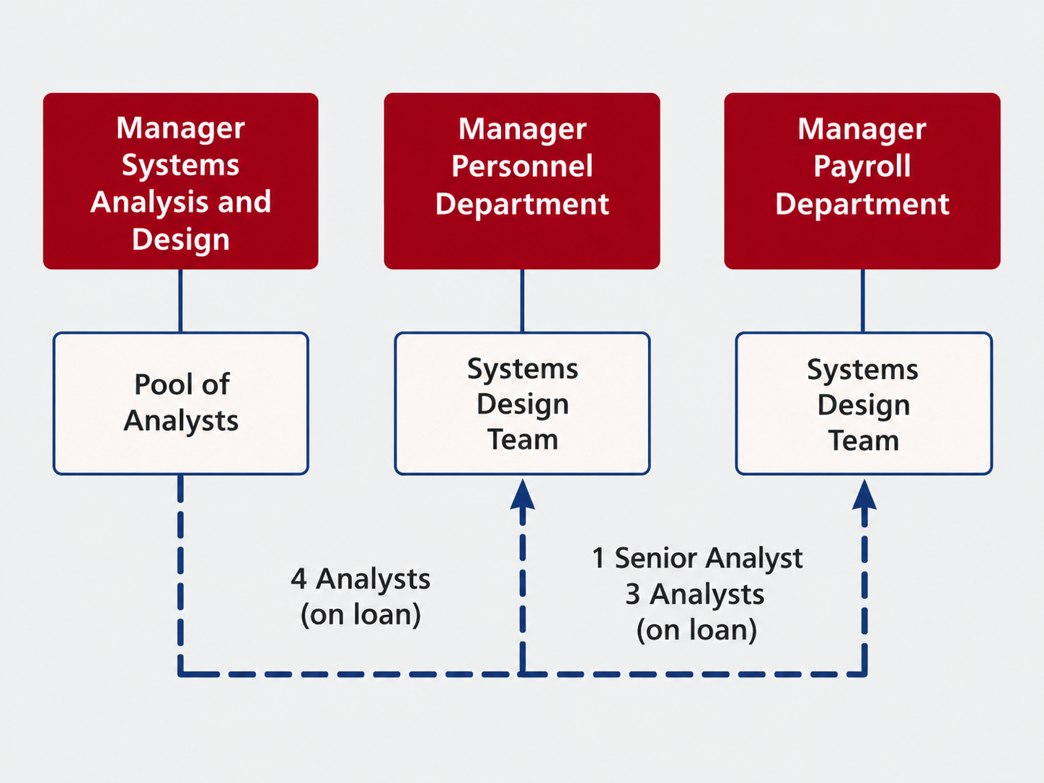
SYSTEMS ANALYSIS & DESIGN STRUCTURES
Pool-Oriented Structure
Analysts are grouped in a common pool and temporarily assigned to departments as project needs arise.
Analysts are assigned to a department for a specific project.
They report to the department manager during the project.
After completing the task, they return to the analyst pool.
Ensures flexibility, user involvement, and better system support.
Figure 4 — Pool-Oriented Structure
A bank keeping one central IT analyst pool that serves HR, Accounts, and Loan departments is a classic example.
21

Slide 22
SYSTEMS ANALYSIS & DESIGN STRUCTURES
Project-Oriented vs. Pool-Oriented
Key Point
Project-Oriented
Pool-Oriented
Basic Concept
Separate teams formed for each project.
Analysts kept in a central pool, assigned as needed.
Analyst Assignment
Permanently assigned to one project until it ends.
Temporarily "on loan" to different departments.
Reporting Authority
Report to their Project Leader.
Report to the Department Manager, then return to pool.
Flexibility
Less flexible — fixed to one project.
More flexible — can move between projects.
Resource Utilization
May duplicate effort; underused skills.
Better utilization — analysts shared across departments.
22

Slide 23
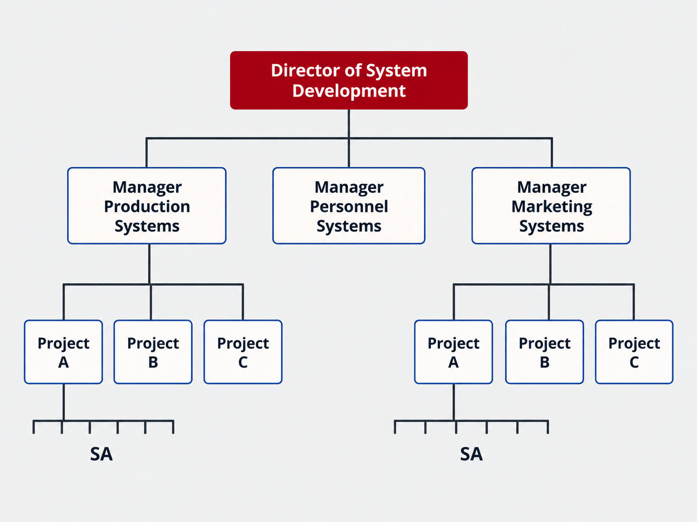
SYSTEMS ANALYSIS & DESIGN STRUCTURES
Functional Structure
Analysts are divided into separate teams, each dedicated to one specific system area of the organization.
Figure 5 — Functional Structure
Personnel Systems Team
Production Systems Team
Marketing Systems Team
Handles employee-related systems.
Manages production-related systems.
Works on sales and marketing systems.
23
Notes:
Suppose there is a large manufacturing company.
They may need:
Attendance, recruitment, and payroll systems for HR
Inventory, machine scheduling, and production tracking systems for Production
Sales tracking, customer databases, and campaign systems for Marketing
In this structure, different analyst teams permanently handle different functional areas.

Slide 24


PRIMARY FUNCTIONS OF AN MIS FACILITY
Programming: Three Areas, Two Approaches
PROGRAMMERS CAN WORK IN TWO WAYS
3 · WORK AREAS
Applications
Pool Approach
Develop new systems and applications.
All programmers belong to one pool and report to a supervisor; each works on different programs individually.
Software
Modify compilers or software packages.
Maintenance
Team Approach
Make updates and fixes to keep systems running.
Programmers work together on one specific project, reporting through a team leader.
24

Slide 25
PRIMARY FUNCTIONS OF AN MIS FACILITY
The Team Approach in Practice
Programmers report to a Lead Programmer (Team Leader).
The team leader reports to the Project Leader.
The project leader (section head) supervises several teams and reports to the Manager of the Programming Area.
Manager, Programming Area
Project Leader (Section Head)
Team Leader
Team Leader
Team Leader
Prog.
Prog.
Prog.
Prog.
Prog.
Prog.
Prog.
Prog.
Prog.
Figure 6 — Team Approach
25

Slide 26


PRIMARY FUNCTIONS OF AN MIS FACILITY
Operations: Keeping Everything Running
The third area manages the day-to-day running of computer systems, coordinated closely with design and programming.
Job Scheduling
Supplies Inventory
Supporting Programming
Data Library
Deciding when programs or tasks will run.
Keeping track of necessary materials.
Backing up day-to-day programming activities.
Storing and organizing data files.
Administration, analysis and design, programming, and operations all work together under one master plan — the coordinated effort that keeps an MIS facility running smoothly.
26

